Slide 1

2023 Open Enrollment Presentation
Mosinee School District

Slide 2

Medical Plan Option 1
Signature HMO HDHP $2,000
Non-Embedded – Family deductible must be met before coinsurance and after-deductible copayments go into effect.
Aspirus Health Plan Signature Network | HMO Plan | Qualified HDHP In-Network Coverage Only*
Deductible Single Family | $2,000 $4,000
Coinsurance | 20%
Out-of-Pocket Maximum Single Family | $4,000 $8,000
Physicians Services Preventive Care Virtual Care Office Visits Primary Care Practitioner Specialist | 0% See MDLive information Deductible, after deductible is satisfied $30 copayment Deductible, after deductible is satisfied $60 copayment
Hospital Services | Deductible and Coinsurance
Walk-in Clinics Urgent Care Emergency Room | Same as Office Visits above. Deductible, after deductible is satisfied $30 copayment Deductible, after deductible is satisfied $200 copayment and coinsurance
Prescription Drugs (After Deductible) | Retail – 30-day supply Tier 1 - $10 Tier 2 - $30 Tier 3 - $60 Specialty – 25% coinsurance | Mail-Order – 90-day supply Tier 1 - $25 Tier 2 - $75 Tier 3 - $150 Specialty – Not applicable
*Emergency room visits and approved prior authorizations are the exception and are covered at the in-network benefit.
Notes:
Option 1: Before the plan starts to cover your costs, you must meet your deductible. This plan has lower premiums compared to option 2 which we will review shortly. This plan is what’s referred to as non-embedded. What does this mean? For families, non-embedded plans require that the family deductible is met before coinsurance and after-deductible copayments go into effect. Shown on this slide is your in-network benefit highlights. Note, there is not out-of-network coverage with this option except for emergency room visits and approved prior authorizations. Under these exceptions, they are covered at the in-network benefit.

Slide 3

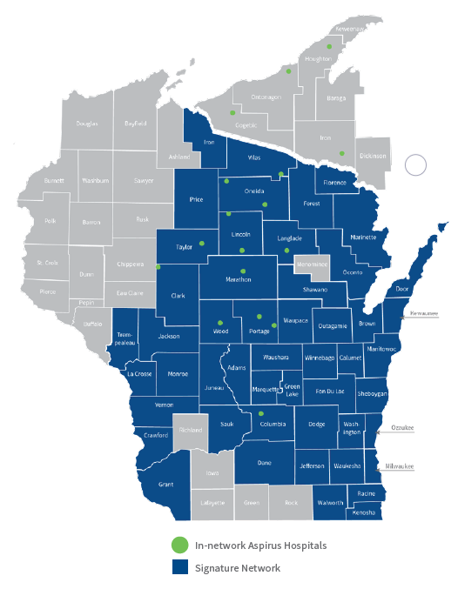
Signature Network
HMO network is referred to as Signature Network.
Aspirus Hospitals in Wisconsin
Aspirus Medford Hospital
Aspirus Wausau Hospital
Aspirus Langlade Hospital (Antigo)
Aspirus Riverview Hospital(Wisconsin Rapids)
Aspirus Divine Savior (Portage)
Aspirus Eagle River Hospital
Aspirus Merrill Hospital
Aspirus Stanley Hospital
Aspirus Tomahawk Hospital
Aspirus Rhinelander Hospital
Aspirus Stevens Point Hospital
Aspirus Plover Hospital
Howard Young Medical Center
Aspirus Hospitals in Wisconsin
Aspirus Hospitals in Michigan’s Upper Peninsula
Aspirus Ironwood Hospital
Aspirus Keweenaw Hospital (Laurium)
Aspirus Ontonagon Hospital
Aspirus Iron River Hospital
Other Hospitals
Aurora Health Care
Bellin Health
Gundersen Health System
Holy Family Memorial
Reedsburg Area Medical Center
ThedaCare
UW Health
Children's Hospital of Wisconsin
The Medical College of Wisconsin
Other Provider Affiliates
Bone & Joint
ENT & Allergy Associates
Forefront Dermatology, S.C
GastroIntestinal Associates, S.C
Pine Ridge Surgery Center
Radiology Assoc. of Wausau, LLP
Surgical Associates, S.C.
Notes:
The first plan option available features the Aspirus Health Plan Signature Network. This network includes Aspirus and other hospitals such as: Children’s Hospital of Wisconsin, UW Health, and other large hospital systems in Wisconsin. This plan does not include Marshfield Hospitals & Clinics .
In addition, the Signature Network is comprised of many other provider affiliates, including Bone & Joint, ENT, GI Associates, Surgical Associates and many more! In short, the Aspirus Health Plan Signature Network is much more than just Aspirus providers.

Slide 4
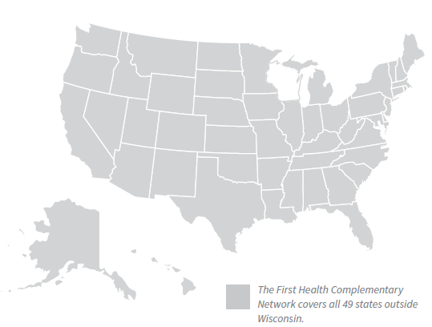
Signature Network Continued
HMO network is referred to as Signature Network.
Outside of Wisconsin
Access to in-network providers through First Health Network. Ideal for those who travel or have dependents living outside of Wisconsin.
Reminder: In an emergency, please go to the nearest emergency room for treatment. Emergency room services pay in-network regardless of provider network participation.
Notes:
Outside of Wisconsin, you have in-network access to providers who are part of the First Health Network. In-network coverage is available to you (or your dependents living outside of WI), through this provider network.

Slide 5
Medical Plan Option 2
Freedom POS HDHP $3,000
Embedded – One person in family cannot meet more than the single deductible and out-of-pocket maximum.
Aspirus Health Plan Freedom Network | POS Plan | Qualified HDHP
 | In-Network | Out-of-Network
Deductible Single Family | $3,000 $6,000 | $6,000 $12,000
Coinsurance | 20% | 40%
Out-of-Pocket Maximum Single Family | $6,000 $12,000 | $12,000 $24,000
Physicians Services Preventive Care Virtual Care Office Visits Primary Care Practitioner Specialist | 0% See MDLive information Deductible, after deductible is satisfied $30 copayment Deductible, after deductible is satisfied $60 copayment | Deductible and Coinsurance Not applicable Deductible and Coinsurance Deductible and Coinsurance
Hospital Services | Deductible and Coinsurance
Walk-in Clinics Urgent Care Emergency Room | Same as Office Visits above. Deductible, after deductible is satisfied $30 copayment Deductible, after deductible is satisfied $200 copayment and coinsurance | Same as Office Visits above. In-network deductible, after deductible is satisfied $30 copayment In-network deductible, after deductible is satisfied $200 copayment and coinsurance
Prescription Drugs (After Deductible) Out-of-Network prescriptions are not covered. | Retail – 30-day supply Tier 1 - $10 Tier 2 - $30 Tier 3 - $60 Specialty – 25% coinsurance | Mail-Order – 90-day supply Tier 1 - $25 Tier 2 - $75 Tier 3 - $150 Specialty – Not applicable
Notes:
Option 2: Similar to option 1, before the plan starts to cover your costs, you must meet your deductible. This plan has higher premiums compared to option 1 due to the expanded network and added out-of-network benefits. In addition, this plan is what’s referred to as embedded. What does this mean? Embedded plans ensure that one person in the family cannot meet more than the single deductible. Thus, if you have a family of three, when member one incurs $2,800 in medical and pharmacy claims, coinsurance and after-deductible copayments will take effect while the other family members work towards the remainder of the family deductible. Shown on this slide are your in- and out-of-network benefit highlights.

Slide 6
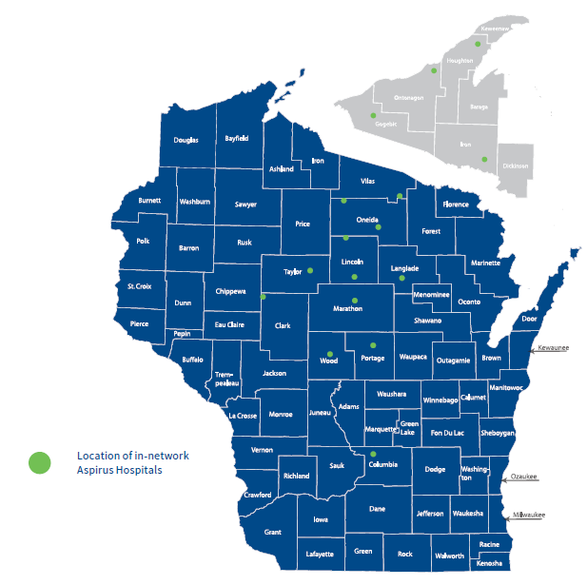

Freedom Network
Comprised of First Health Network providers in Wisconsin.
In addition to Signature Network providers, the Freedom Network includes:
Marshfield Hospitals and Clinics
Oakleaf
Froedtert
Etc.
Outside of Wisconsin
Access to in-network providers through First Health Network. Ideal for those who travel or have dependents living outside of Wisconsin.
Reminder: In an emergency, please go to the nearest emergency room for treatment. Emergency room services pay in-network regardless of provider network participation.
Notes:
The second plan option available to you features the Aspirus Health Plan Freedom Network. This network includes providers in the Aspirus Signature Network and additional Wisconsin-based providers that are contracted through the First Health Network. As such, this network would provide you with access to Marshfield Hospitals and Clinics, Oakleaf, Froedtert, and more.
The same as with the Signature Network, outside of Wisconsin, you have in-network access to providers who are part of the First Health Network. In-network coverage would be available to you (or your dependents living outside of WI), through this provider network.

Slide 7
Freedom Network Continued
Non-Participating Providers
Providers not shown in the Signature, Freedom, or First Health Network (outside Wisconsin) are considered Non-Participating Providers. Any services rendered, with the exception of emergency room visits and approved prior authorized services, apply to non-participating provider benefits.
Note: Deductible and out-of-pocket amounts for non-participating providers do not credit toward the participating provider deductible and out-of-pocket amounts or vice-versa.
Non-participating providers are generally more expensive – as there are not contractual agreements in place. As such, you could face the potential for “balance billing” – and these additional amounts do not track toward deductible and out-of-pocket.
Here’s an example: You go to an out-of-network hospital, which charges $1,500 for an overnight stay. If the allowed amount is $1,000, you may have to pay the $500 difference.
Notes:
Providers not shown in the Signature, Freedom, or First Health Network (outside Wisconsin) are considered Non-Participating Providers. Any services rendered, with the exception of emergency room visits and approved prior authorized services, apply to non-participating provider benefits.
Note: Deductible and out-of-pocket amounts for non-participating providers do not credit toward the participating provider deductible and out-of-pocket amounts or vice-versa.
Non-participating providers are generally more expensive – as there are not contractual agreements in place. As such, you could face the potential for “balance billing” – and these additional amounts do not track toward deductible and out-of-pocket.
Here’s an example: You go to an out-of-network hospital, which charges $1,500 for an overnight stay. If the allowed amount is $1,000, you may have to pay the $500 difference.

Slide 8




Find A Doctor
To search for providers:
Visit AspirusHealthPlan.com/Group, click on Find a Doctor at top of the page.
1
2
If you agree, click “I Agree.”
This will direct to a search page where you can identify health care providers or hospitals in the Signature Network, Freedom Network or First Health Network.
3
Note, for those who elect the Freedom Network, since Signature Network providers are included in the Freedom Network, but not all Signature Network providers are reflected in the Freedom Network, it is recommended that you search in this order:
Signature Network
2
Freedom Network
Notes:
To search for providers, visit AspirusHealthPlan.com/Group, click on Find a Doctor at the top of the page, and if you agree, click the I Agree button.
You will be taken to a search page where you can search for a health care provider or hospital in the Signature Network, Freedom Network, or First Health Network.
For those who elect the Freedom Network Plan Option:
Since Signature Network providers are included in the Freedom Network, but not all Signature Network providers are reflected in the Freedom Network search, it is recommended that you search in this order:
Signature Network
Freedom Network

Slide 9
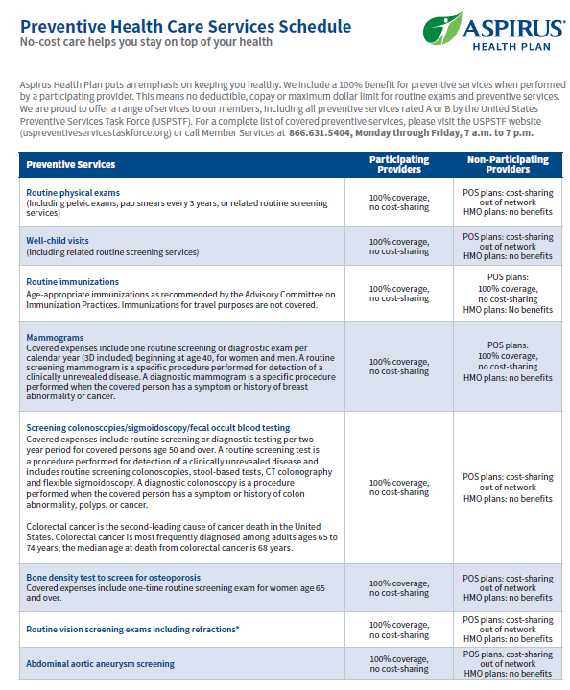
Preventive Services
Both plan options provide 100% coverage for preventive services by in-network providers.
Mammograms (including 3D)
  One covered per calendar year
Colonoscopies, sigmoidoscopies and other screenings for colorectal cancer
  Limited to one every two benefit years
Vision Exams (including refractions)
  One covered per benefit year
Comprehensive physical examinations (including well-baby, well-child and adolescent and adult care visits)
Immunizations and vaccines
Nutritional counseling
Gynecological exams
Digital Prostate exams
Preventive hearing tests
Bone mineral density (dexa scan) to screen for osteoporosis
Certain screening labs* (BRCA 1 & 2 genetic testing, breast cancer genetic testing)
*Screenings may require prior approval. Visit www.aspirusheatlhplan.com for additional details.
Notes:
Both plans provide 100% coverage for preventive services by in-network providers. This means that these services would pay at 100% and would not be subject to your deductible. Included in the preventive benefit are a few services that will pay at 100% regardless of whether they are billed as preventive or diagnostic services. These include:
Mammograms (including 3D) – limited to one per benefit year. Additional mammograms would be subject to your deductible
Colonoscopies - limited to one every two years. Again, additional screenings would be subject to your deductible
Vision exams – limited to one per benefit year
The other services noted above are also part of the 100% preventive benefit – but would need to be coded or billed, by your health care provider, as a routine/preventive service.

Slide 10
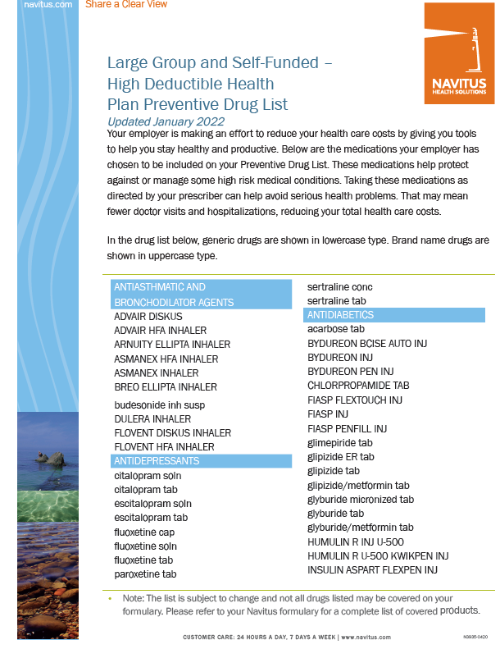
Preventive Drug List
All plans provide 100% coverage for certain medications.
Certain medications are required to be covered as “preventive” as defined by the Affordable Care Act (“ACA”). Some examples:
Contraceptives
Nicotine replacements and smoking cessation medication (if age 18 and older, limited to 180-day supply
Medications are not subject to deductible or prescription drug copayments.
Notes:
Aspirus Health Plan offers some medications at no-cost to you. These are considered preventive medications and a listing can be found in your packet. If you are currently taking any medications, please take a look at this list and bring to your doctor's office to see if you should be prescribed any of these in lieu of current medications to take advantage of the savings.

Slide 11



Pharmacy Benefit Manager (PBM)
Pharmacy Benefit Management services are through Navitus and their wholly-owned specialty pharmacy, Lumicera.
Pharmacy Benefit Manager
Specialty Pharmacy
Mail-Order Vendor
Allowed up to a 90-day supply of medication through retail or mail-order.
Retail pharmacies include, but are not limited to: Wal-Mart, Walgreens, CVS, Young’s Drug Store, etc.
Limited to 30-day supply of medication dispensed through Lumicera.
If you elect mail-order, Postal Prescription Services (PPS) is the vendor that will dispense.
Notes:
We’ve reviewed the medical benefits, now let’s focus on the prescription drug benefit. Pharmacy Benefit Management services are through Navitus and their wholly-owned specialty pharmacy, Lumicera.
Through Navitus, you are allowed up to a 90-day supply of medication through retail or mail-order. Retail pharmacies include, but are not limited to: Wal-Mart, Walgreens, CVS, Trigs, Young’s Drug Store, etc. For mail-order, we partner with Postal Prescription Services or PPS which we will touch more on in the next slide.
With specialty medications, you are limited to a 30-day supply, and they must be filled by Lumicera.

Slide 12
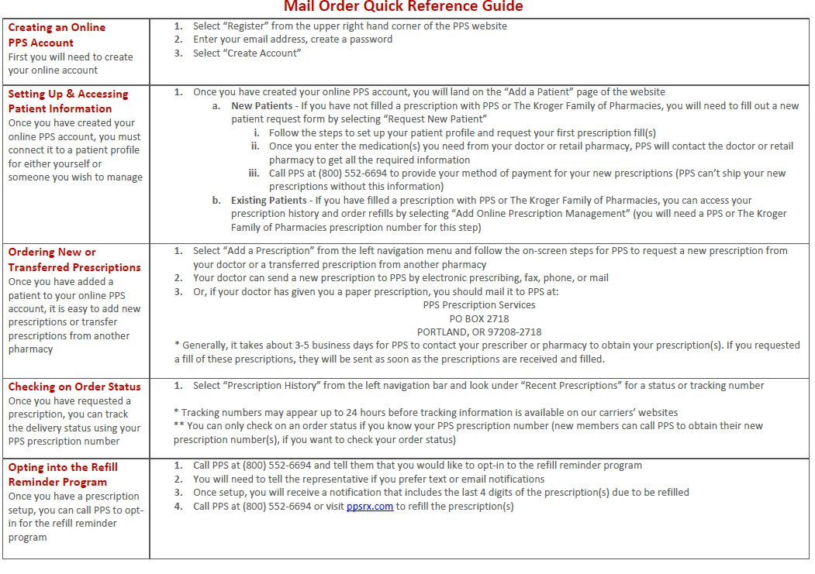
Postal Prescription Services (PPS)
Mail-Order Program
www.PPSRX.com
1.800.552.6694
If you are interested in the mail-order program, call PPS at the number listed above. They can assist with:
  Setting up your account
  Obtaining prescriptions from your physician
  And filling medications through the mail-order program
Notes:
As noted, PPS is the mail-order program where you can fill your prescriptions up to a 90-day supply. If you are interested in the program, please contact PPS at 1.800.552.6694. They will walk you through the process of filling your mail-order medication. Prior to that date, please make sure you have enough medication on hand.

Slide 13
Other Value-Added Benefits

Slide 14
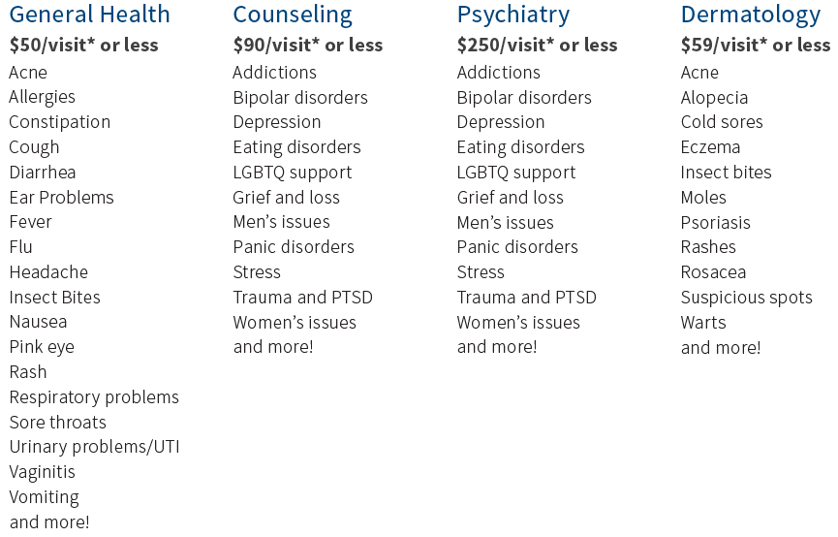
MDLive
MDLive is an alternative to traditional health care.
1.888.632.2738
Board certified doctors can visit with you either by phone or secure video to help treat any non-emergency medical conditions.
Licensed behavioral health therapists offer online video therapy sessions, on your schedule from wherever you’re located.
Notes:
MDLive is an alternative to traditional health care. Board certified doctors can visit with you either by phone or secure video to help treat any non-emergency medical conditions.
Licensed behavioral health therapists offer online video therapy sessions, on your schedule from wherever you’re located.

Slide 15

Nurseline
Provides access to valuable assistance, support and resources at no cost to you.
1.866.220.3138
Access to services 24 hours a day, 7 days a week.
Unlimited telephone calls to Nurseline Medical Services Representatives and Nurses
Calls are screened for priority so that the most urgent calls receive immediate attention by the RN.
Staffed by Registered Nurses with an average of 20-years of experience.
Unlimited access to Nurseline audio library with 400+ messages on general topics
Notes:
Available under all benefit plan options, our Nurseline provides access to valuable assistance and ensures easy access to support and resources, whenever and wherever you need them.

Slide 16

Exercise Rewards
Fitness reimbursement program where you can earn a $30 reward each month.
Who qualifies?
Must be age 18+
Enrolled on the health plan
Visit an eligible facility (workouts from home are not eligible)
How do you earn the $30 reward?
Visit eligible facility at least 10-times a month for 30-minutes each visit.
How do you track visits?
ASHConnect mobile app
Complete paper visit submission form and submit to ASH
Automatic submission – a limited number of facilities will submit your visits on your behalf
How do I claim my $30 reward?
Login to www.ExerciseRewards.com and go to Rewards to redeem.
Otherwise, after period passes, the reward will automatically be mailed.
To be considered an eligible facility, must meet this criteria:
Must have staff oversight and be open to the general public.
Must offer a membership agreement.
Must collect monthly or yearly fees and indicated by the membership agreement.
Must have a clean Better Business Bureau record.
Must carry liability insurance.
Exclusions/limitations include rehab or physical therapy centers, martial arts centers, gym centers, hotels, social clubs or sports teams/leagues.
Notes:
Through a partnership with American Specialty Health, Aspirus Health Plan offers Exercise Rewards. Exercise Rewards is a fitness reimbursement program. Through this program, if you visit an eligible facility 10-times a month for at least 30-minutes each visit, you can earn a $30 reward. You must be age 18 or older, enrolled on the health plan, and visit an eligible facility. Some facilities locally that participate are the YMCAs, Lift, Planet Fitness, Anytime Fitness, Franck’s Gym, and Greenheck Fieldhouse.
To track your visits, you can use the mobile app, ASHConnect, complete the paper log form, or some facilities will submit on your behalf if you request to be added to the list (YMCA).

Slide 17
Smoking Cessation
Cessation aids covered at 100%
Who qualifies?
Must be age 18+
Enrolled on the health plan
Have a prescription written by a doctor (including for over-the-counter products)
Fill the prescription at an in-network pharmacy
What is covered?
Up to twice a year, your plan covers 100% of the cost for three months – 90-day supply – of these smoking cessation aids:
Over-the-counter nicotine replacement products, such as a patch, gum, or lozenges
Prescription nicotine replacement products, such as a patch, inhaler, or nasal spray
Prescription non-nicotine medications, such as Chantix or Nicotrol
Notes:
Smoking cessation is a benefit offered to help you kick tobacco to the curb. With this benefit, you have access to a 90-day supply of smoking cessation aids up to twice a year. Note, you must be age 18 or older, enrolled in the health plan, prescribed the medication by a doctor even if it’s over the counter, and it must be filled at an in-network pharmacy.

Slide 18

BenefitHub Discount Program
Aspirus Health Plan also offers a Member Discount Program, where you may be able to take advantage of discounts, rewards and other incentives on many brand items.
Notes:
Aspirus Health Plan is pleased to offer a Member Discount Program where you can take advantage of discounts, rewards and other incentives provided by many retailers. This benefit is available for all covered members.

Slide 19
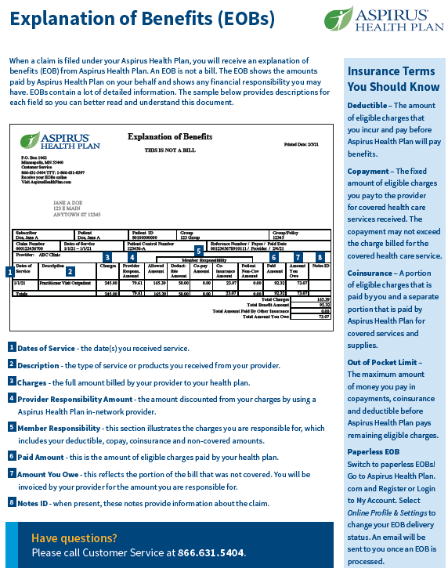
Accessing Benefit Information
We encourage you to register for the member portal.
Aspirus Health Plan
www.AspirusHealthPlan.com
Phone: 1.866.631.5404
When you create your Aspirus Health Plan login, it will automatically link your prescription drug benefits. Always use your Aspirus Health Plan portal to access prescriptions benefits.
Access temporary ID cards, Explanation of Benefits (EOBs), and more.
1
Navitus
Navitus Mobile App
Phone: 1.844.268.9789
2
Notes:
We encourage you to register for your member portal. Your login information is linked to your prescription benefits through Navitus. If you download the Navitus mobile app, the login information will be the same as your Aspirus Health Plan account. Please setup your Aspirus Health Plan account first.

Slide 20
Thank you

